Slide 1
Startrac Coffee Company
Problem 3.12
By: Paul Dang and Carlos Revilla

Slide 2
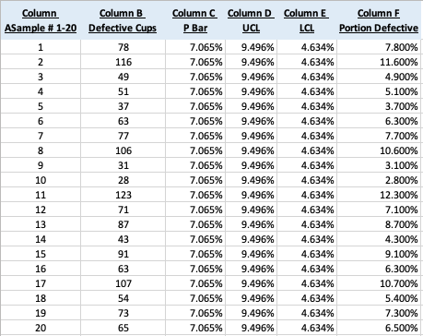


Calculations
3 Sigma was used for all of the above calculations

Slide 3
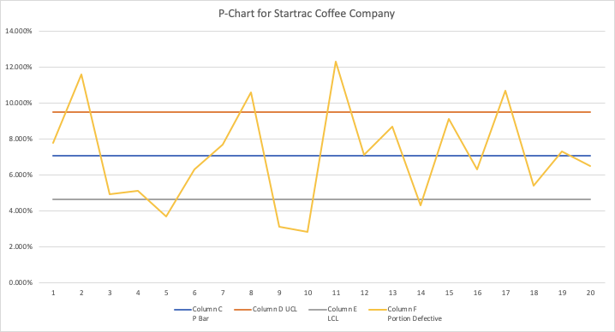
P - Chart Analysis (3 Sigma)
The P-Chart shows several issues:
There are obvious points where defective proportions fall outside the LCL and UCL
Happens 8 times with a 3 sigma

Slide 4
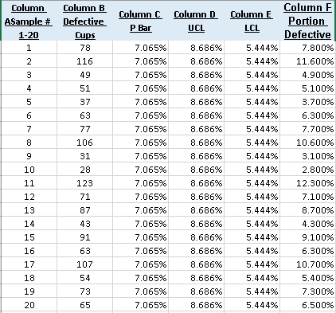

Calculations for Task 3
Sigma 2 was used for all calculations

Slide 5
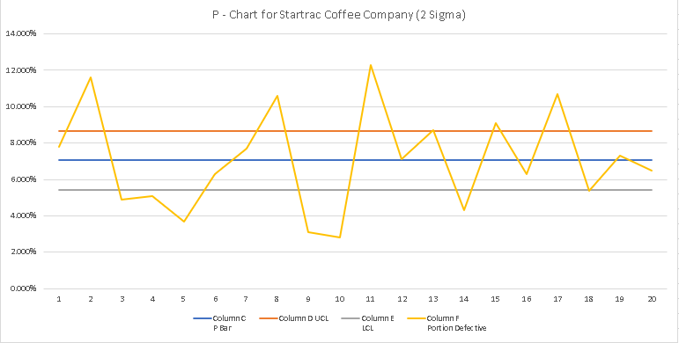
P - Chart Analysis (2 Sigma)
The process is not in control when using 2 sigma as the control limit.
The graph surpasses the UCL and LCL 13 times
The Quality Criteria, as 2 Sigma, displayed a lower quality
UCL and LCL closer to each other
Creates 5 extra defective proportions

Slide 6
Task 4: Does using 2-sigma change the process, and is it still in control?
Using 2-sigma instead of 3-sigma only narrows down the upper and lower limits for control. In our analysis, we found that this resulted in showing more errors, but this does not mean that the original data changes; only our criteria for what is above and below the limits changes.
The process is still out of control using 2-sigma, but using the new UCL and LCL, we can see that the process has additional outstanding points as compared to the 3-sigma p-chart.

Slide 7
Task 5: Analyze your results when the Quality Criteria changed from 3 to 2 sigma. Did quality improve or decline?
When we changed the Quality Criteria from 3 to 2 sigma, our quality declined drastically. When using sigma 2, the UCL and LCL were pushed closer to the average line of the P-Chart, increasing the likelihood for defects.
However, the amount of defects of the company product has not changed; rather, the perception of what constitutes as a defect becomes increasingly strict - resulting in a greater amount of defects found by the P - Chart.

Slide 8
Task 6: Briefly describe 5 other quality management tools and how you think the company might employ them to improve their quality management program.
Checklists: These tables show the steps and procedures that are needed to achieve quality
This can show the company the exact step where the defect occurred
Histograms: These are used to record numerical information as a visual chart
This is helpful to immediately see any trends of quality occurring at which sections
Pareto Charts: They show data sets in order of size, immediately showing which causes should be addressed
This can be used to assess quality by immediately seeing the cause and impact the defects have to ultimately rid the processes of the cause
Scatter Diagrams: This helps show the cause and effect of processes by comparing variables
Comparing data into points on a chart will give a representation of the most common error in the system, recognizing it, and solving the defect to deliver a quality product
Flow Charts: Used to display the steps of a process to understand what part of the process needs correcting
Similar to the checklist, this helps find exactly where the quality issues happen and how to assess them

